Slide 1
Mid-States Organized Crime Information Center® (MOCIC)
Overview of Services

Slide 2
Regional Information Sharing Systems® (RISS)
Federally funded through the Bureau of Justice Assistance (BJA), Office of Justice Programs (OJP), U.S. Department of Justice (DOJ)

Slide 3
RISS
Nationwide program comprised of six regional centers and a technology support center
The six regional centers serve nearly 9,000 member agencies, with over 110,000 officers having direct access to RISS services
*stats from June 2013

Slide 4
6 Regional RISS Centers
NESPIN
MAGLOCLEN
WSIN
MOCIC
RMIN
ROCIC

Slide 5
Mid-States Organized Crime Information Center® (MOCIC)
One of the six regional RISS centers
Established in 1980
Provides services to member agencies from nine states throughout the Midwest, as well as the Canadian province of Manitoba

Slide 6
Mid-States Organized Crime Information Center® (MOCIC)
Over 1,600 member agencies
More than 13,000 officers with direct access to MOCIC/RISS services
*stats from June 2013

Slide 7
MOCIC Region
NORTH DAKOTA
MINNESOTA
WISCONSIN
SOUTH DAKOTA
IOWA
NEBRASKA
ILLINOIS
KANSAS
MISSOURI

Slide 8
MOCIC Services
Analytical
Criminal Information Services (CIS)
Cell Phone Forensics
Confidential Funds
Equipment
Publications
RISSNET™ Tech Support
Training
Intelligence/Officer Safety Services

Slide 9
Analytical Section
Provides case support and analysis to members
Case consultations
Products/charts customized for each case
Link charts, flow charts, timelines
Courtroom graphics
Cell phone tower charts
Crime scene diagrams
Financial analysis
Photo enlargement

Slide 10
Criminal Information Services (CIS) Section
Provides investigative assistance by obtaining information from a variety of resources
RISS database searches and entry
Driver’s license photos
Locate fugitives or witnesses
Historical/associate information
Locate identifiers
Phone subscriber information
Law enforcement contacts

Slide 11
Cell Phone Forensics
Service reinstated in August 2013
Assists agencies by gleaning valuable information from cellular devices
Cellebrite’s UFED device
Need copy of SW before performing the extraction

Slide 12
Confidential Funds
Agencies can request funds to pay for covert operations, including informant expenses and the purchase of evidence, when no other funding source is available
For more information or to request confidential funds, members should contact the MOCIC Comptroller – (800) 846-6242 ext. 4103

Slide 13
Equipment Section
Members can borrow equipment from our inventory
Equipment is loaned at no charge and is available on a first-come, first-served basis
Required to complete the MOCIC Equipment Request Form
Download from the MOCIC homepage
Contact the Equipment Section to request the form - (800) 846-6242 ext. 4221

Slide 14
Equipment Section (cont’d)
Variety of investigative equipment available
Surveillance equipment
Communication equipment
IP pole cameras can be custom-built for agencies to purchase at cost
Video enhancement
Audio filtering and enhancement

Slide 15
Publications
The Criminal Information Digest-Online is MOCIC’s monthly publication
Currently offered in digital format and can be accessed from MOCIC’s homepage
Provides valuable information for law enforcement officers
Intel
Training opportunities
Officer safety information
Case specific articles

Slide 16
Publications (cont’d)
Members can submit information for inclusion in the Digest

Slide 17
RISSNET Technical Support
MOCIC’s Help Desk is available Monday-Friday from 8:00 a.m. to 5:00 p.m.
Staff provides support to members who are trying to access RISSNET and its resources
Maintains Security Control Cards on file for all members accessing the secure network

Slide 18
Training Section
Two POST-certified courses taught by MOCIC staff
Practical Applications of Surveillance Equipment (PASE)
Revamped in 2013
Basic Financial Investigation Techniques (BFIT)
Each year MOCIC coordinates an Annual Conference and Training Session
POST-certified training
Top notch instructors from across the nation
Location of the Conference rotates throughout the nine-state MOCIC region

Slide 19
Training Section (cont’d)
The training section also facilitates various training sessions that are held at our headquarters building in Springfield, MO
A list of current training offered in the MOCIC region, included those courses taught by MOCIC staff, can be found on the MOCIC homepage under the Training Announcements link

Slide 20

Intelligence/Officer Safety Services
RISSIntel™
Secure, nationwide criminal intelligence database that is connected to the other 5 RISS centers, as well as other state intelligence databases
28 CFR Part 23 compliant
Accessible 24/7
Approximately 2.5 million intel records in the database
340,000 from the MOCIC region
Additional 1 million searchable records from Non-RISS type 1 nodes
Approximately 1.2 million searches each quarter
*stats through 2012

Slide 21
Intelligence/Officer Safety Services (cont’d)
Quality control of all intelligence that goes into RISSIntel
Submitted by members and entered by MOCIC staff
Remote entry
Batch upload process

Slide 22

Intelligence/Officer Safety Services (cont’d)
RISSGang™
Comprehensive tool to assist law enforcement agencies working gang-related investigations
National Database
Suspects, vehicles, symbols, tattoos, etc.
Website
Bulletin Board

Slide 23

Intelligence/Officer Safety Services (cont’d)
RISSLeads Investigative Website™
Website dedicated to searching for and sharing investigative information
Upload documents, photos and videos
Search data sources
Collaborate on cases
Discuss investigative leads
Training/Events
Links to other RISS services/databases

Slide 24

Intelligence/Officer Safety Services (cont’d)
RISS Officer Safety Website
Nationwide repository for issues related to officer safety
Awareness information
Videos
Training information
Armed and dangerous subjects
Concealment methods
Narcotics awareness information
Border security information

Slide 25

Intelligence/Officer Safety Services (cont’d)
RISSafe™ - Officer Safety Event Deconfliction System
Only comprehensive and nationwide deconfliction system
Accessible 24/7
Watch Centers monitor operations and make notifications for conflicts
Operations can be entered in a variety of ways
Call, fax or e-mail Watch Center
Remote entry by officer
Mobile app entry
Nationwide: 168,097 operations with 81,027 conflicts
MOCIC Region: 7,178 operations with 1,249 conflicts
*stats for 2012

Slide 26

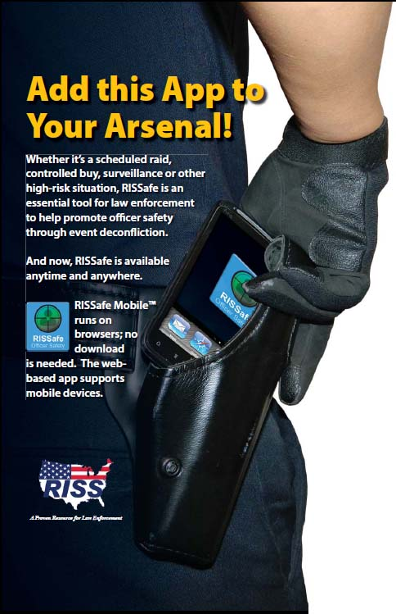

Intelligence/Officer Safety Services (cont’d)
RISSafe Mobile™
Smartphone app deployed in April 2012
Officers can enter operations and receive notifications of conflicts utilizing mobile devices

Slide 27

Intelligence/Officer Safety Services (cont’d)
RISS ATIX™
Extends secure information exchange beyond law enforcement
Web pages
Bulletin board
Document library
Secure e-mail
Participants choose a “community” group based on their responsibilities
Public utilities
Education systems
Financial institutions
Emergency management agencies
Other

Slide 28
Intelligence/Officer Safety Services (cont’d)
Collaboration Website
Customized website
Secure sharing environment for a group of people
Intradepartmental
Multi-jurisdictional
Wide-area investigations
Burglary task forces
Drug task forces

Slide 29
For more information about MOCIC or RISS please contact us
(800) 846-6242
info@mocic.riss.net

